Slide 1

Chapter 8
Group data

Slide 2
Content
When to group data?
How to group data?
Examples

Slide 3

Example 1: why group data?
This shoe store has an alphabetical list of all the shoe brands they sell (from a database or a file).
On the website, brands are grouped by highlighting the first letter of the brand name.

Slide 4
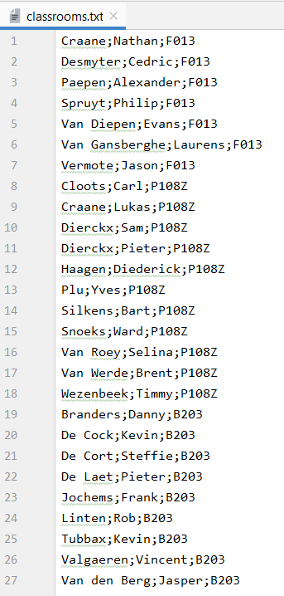
Example 2: why group data?
One of your colleagues made a file with the name of each student and the room where that student is taking the exam.
You want a List with the number of students per classroom.
Note: the records in the file are grouped by classroom (not ordered by room number!)

Slide 5
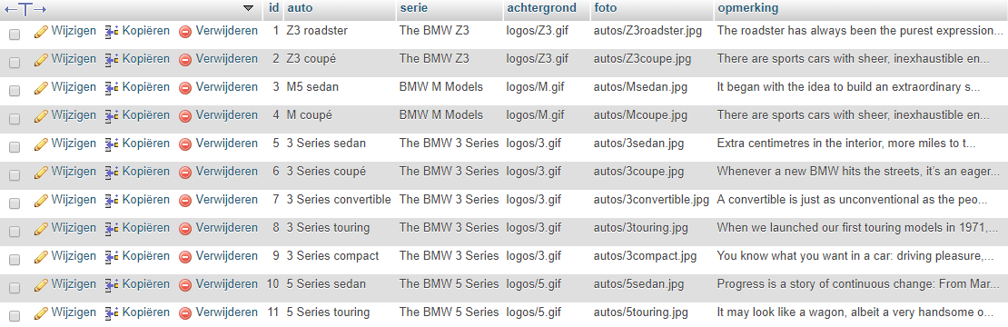
Example 3: why group data?
On the BMW website, all models (column car in database table) must be grouped by series (column series in database table).
car
series

Slide 6

Example 3: why group data?
Desired result

Slide 7
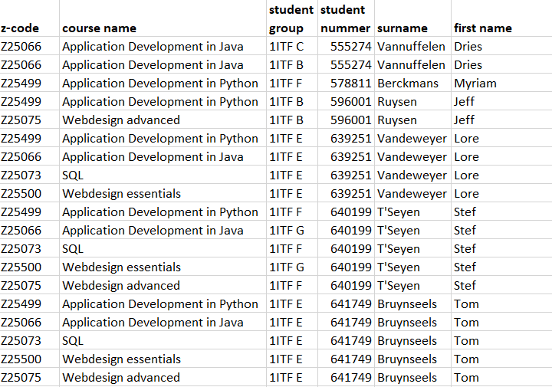
Example 4: why group data?
You have a file that contains all the courses that each student takes + the name of the class in which he is taking the course.
The list is grouped by student and there are as many rows as courses for each student.

Slide 8
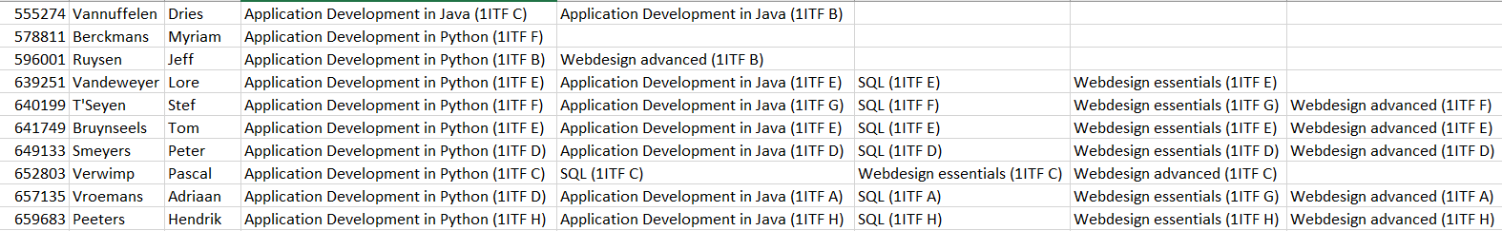
Example 4: why group data?
You want a new file with only one row per student.

Slide 9
How to group data?
“Group data” is a programming technique that you can use if you
have access to a (large) amount of sorted data and you would like to group this data according to a certain criterion
know that after a group of data with the same 'key' comes another set. You want to keep the data of that group together and find exactly where the group stops.
This technique is often used when creating reports based on a sequential file, but is also often used in other situations (see previous examples).

Slide 10
How to group data?
program start instructions
while not_end_data:
group start instructions
while not_end_data and in_the_same_group:
actions for that one element of the group
take next element of the group
group final instructions
program final instructions

Slide 11

How to group data: example with string
Example:
The string contains 5 groups of characters. Each group is characterized by a character.
At the beginning of each (new) group we have to define this characteristic by a special variable, the "indicative". We use this as an indication as we walk further through the string.
At some point we will discover that the character we are reading no longer corresponds to this indicative. One group stops there and we have to start the next group.
a | a | a | a | a | d | d | d | p | p | p | p | p | p | s | s | s | s | s | s | s | s | s | w | w

Slide 12
How to group data: example with string
text = input('Enter a (grouped) sequence of characters: ') print('The compressed text: ', end='') i = 0 while i < len(text):
characterind = text[i] number_characters = 0
while i < len(text) and text[i] == characterind:
number_characters += 1 i += 1
print('('+str(number_characters)+characterind+')', end='') print()
program start instructions
while not_end_data:
group start instructions
while not_end_data and
in_the_same_group:
actions
group final instructions
program final instructions

Slide 13

How to group data: example with List
We have a list that contains all the drinks that people ordered:
We want this new list as a result:
orders = ['chocolate milk', 'chocolate milk', 'chocolate milk', 'chocolate milk’,
'coffee', 'coffee', 'coffee', 'coffee', 'tea', 'tea']

Slide 14
How to group data: example with List
orders = ['chocolate milk', 'chocolate milk', …, 'tea', 'tea'] overview = [] counter = 0
while counter < len(orders):
drinkind = orders[counter] number = 0 while counter < len(orders) and orders[counter] == drinkind: number += 1 counter += 1 overview.append([drinkind, number]) print("Overview of the orders:") print(overview)
program start instructions
while not_end_data:
group start instructions
while not_end_data and
in_the_same_group:
actions
group final instructions
program final instructions

Slide 15
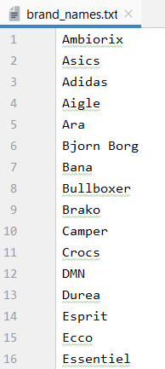
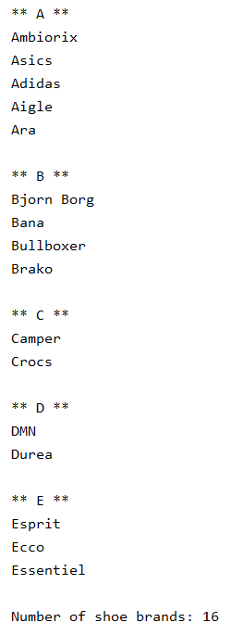
How to group data: example with file
We make this overview of the given text file with (shoe) brand names

Slide 16
How to group data: example with file
with open('brand_names.txt') as file: number_of_brands = 0 line = file.readline() while line: brandind = line[0] print("**", brandind, "**") while line and line[0] == brandind:
number_of_brands += 1 print(line, end='') line = file.readline() print() print("Number of shoe brands:", number_of_brands)
program start instructions
while not_end_data:
group start instructions
while not_end_data and
in_the_same_group:
actions
group final instructions
program final instructions

Slide 17
How to group data: example2 with file
With the information from the file we create a List with the number of students per classroom.
In the input file we will read line by line.
Each line is split up:
record[0] contains the surname
record[1] contains the first name
record[2] contains the classroom number

Slide 18
How to group data: example 2 with file
room_list = [] with open('classrooms.txt') as file: line = file.readline().rstrip() record = line.split(';')
while line: roomind = record[2] number_per_room = 0 while line and record[2] == roomind: number_per_room += 1 line = file.readline().rstrip() record = line.split(';') room_list.append([roomind, number_per_room]) print(room_list)
program start instructions
while not_end_data:
group start instructions
while not_end_data and
in_the_same_group:
actions
group final instructions
program final instructions

